Slide 1
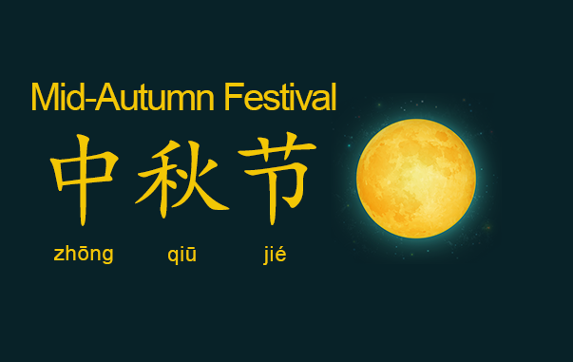


Slide 2
_运输_
Yùnshū

Slide 3
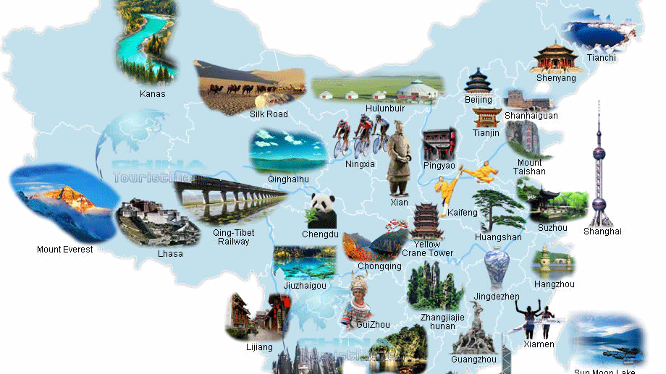
名胜古迹

Slide 4
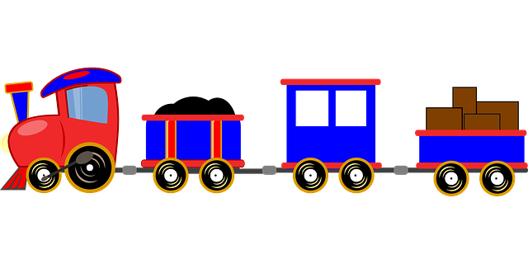
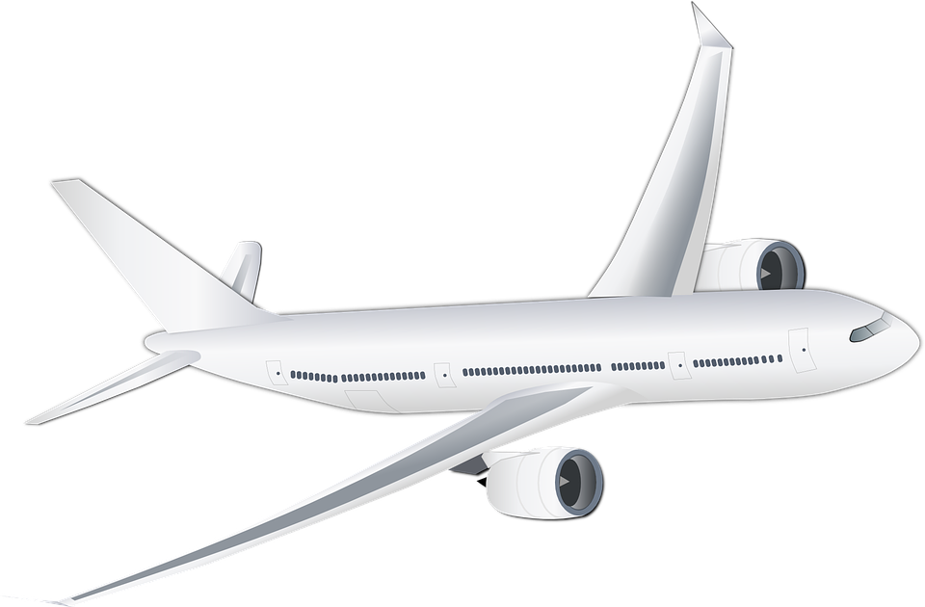
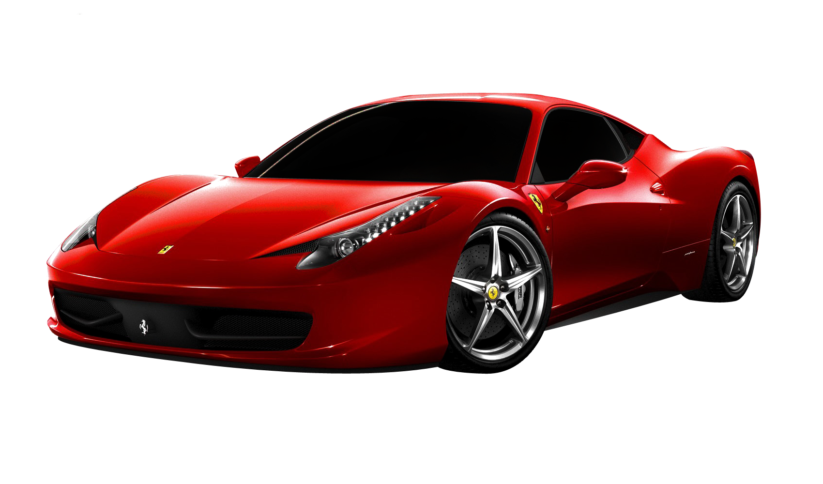
Types of Transportation
Train (地铁 or火车)
Plane (飞机)
Car (汽车)
This Photo by Unknown Author is licensed under CC BY-NC

Slide 5
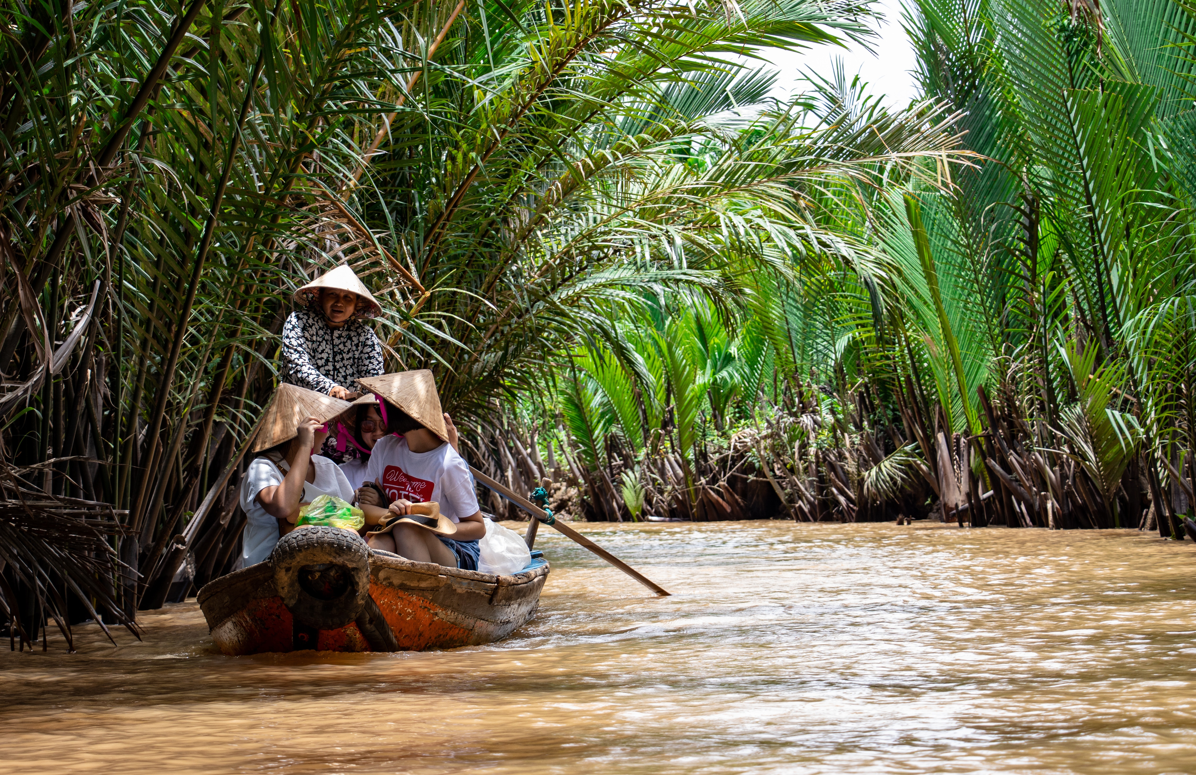
谁在中国旅游?
Who’s traveling in China?
Nearly 90 million people traveled in anticipation for this year’s festival
Close to 6 billion dollars was spent on that travel (~40 billion yuan)
今年人订旅馆越来越少
Over half of the trips were short distance

Slide 6


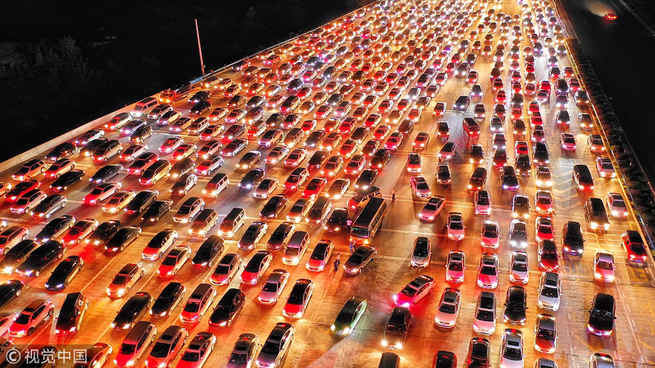


Slide 7
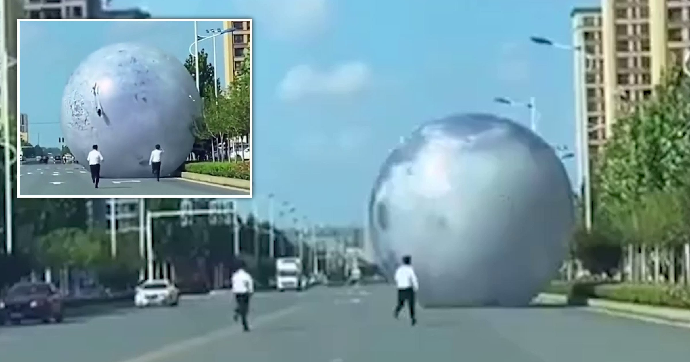

Slide 8

Pandemic 新冠肺炎
更少的人旅行
Big travel agencies were hurt during this year’s festival
Local tourism still did well
很多旅游公司做得不好
Numbers starting to rebound now that COVID-19 is under control
很快就会有更多的旅行

Slide 9


